Slide 1
Office 365 Development

Slide 2
O3656-5 SharePoint 2013 Remote Event Receivers
Speaker
Speaker

Slide 3

Agenda
Motivation
Remote Event Receiver Architecture
Debugging Remote Events
Creating Remote Event Receivers
App Lifecycle Events

Slide 4
Motivation

Slide 5
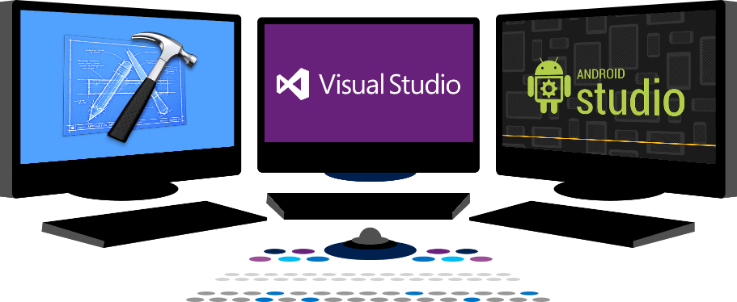














Vision
EXTEND OFFICE EVERYWHERE
CONNECT TO OFFICE 365 SERVICES
BUILD USING AN OPEN PLATFORM
Delve
z
Users and groups
Files
Mail
Calendar
My Apps
Video Portal
Contacts
Office Graph
Presentations
Documents
Spreadsheets
Lync
OneNote
Yammer

Slide 6
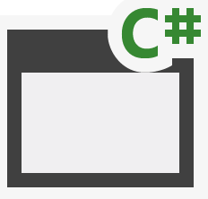
SharePoint App Building Blocks
SharePoint Apps
aspx
Databases
png
master
CSS
js
Web Services
SharePoint
REST
CSOM
SharePoint API
Managed
Metadata
Search
Service
Workflow
Service
BCS
List and Libraries
Service Applications

Slide 7
Why Use Remote Event Receivers?
Respond to user actions and modifications to content
Add validation logic for columns on list items
Cleanup and format content as it is entered by users
Calculate and store aggregated values
Initialize host web with new lists during app installation

Slide 8
Remote Event Receiver Architecture

Slide 9
Event Handling Support in SharePoint 2013
Classic server-side events for SharePoint solutions
Supported as early as SharePoint 2003
Based on ‘before’ events and ‘after’ events
Event handlers implemented using event receiver class in C#
Event handler assembly loads into SharePoint worker process
New remote event infrastructure introduced for app model
Event handler code runs in remote web not in SharePoint host
SharePoint calls web service in remote web to trigger event
Set of supported remote events is subset of server-side events
Remote “before” events implemented as two-way events
Remote after events implemented as one-way events

Slide 10
Supported Remote Events
Site
Create
Move
Delete
Create
Delete
List Schema
Create
List Item
Create
Update
Delete
Move
CheckIn
Attachment Added
File Moved
App
Install
Uninstall
Update
Delete
UnCheckIn
CheckOut
Attachment Removed
File Converted
List
Update
Notes:
The goal is to make the remote event receivers equivalent to the standard event receivers in SharePoint.
In cases where latency is high, remote synchronous events could cause significant delays in the operations that the event is responding to. Synchronous events are available today, though, and they’re important, especially for complex data validation rules.

Slide 11
Remote “Before” Events
Remote before events modeled as two-way events
Execution flow goes to remote web and then back to SharePoint
Client is blocked while event processing occurs in remote web
Sample execution flow for two-way event
Client attempts action which triggers an event (e.g. update item)
SharePoint host calls to web service in remote web
SharePoint host blocks until call returns from remote web the key point is that two-way events block the SharePoint host and delay response back to user
SharePoint host commits action and returns to Client
Two Way Event (aka before event)
Client
1
SharePoint Host
Remote Web
2
3
4

Slide 12
Remote “After” Events
Remote after events modeled as one-way events
Execution flow goes to remote web but does not return
Unlike before events, after events do not block client response
Sample execution flow for one-way event
Client attempts action which triggers an event (e.g. update item)
SharePoint host commits action and returns to Client
SharePoint host executes one-way WCF call on remote web the key point is that one-way events do not block the SharePoint host nor delay response back to user
One Way Event (aka after event)
Client
1
SharePoint Host
Remote Web
2
3

Slide 13
Debugging Remote Events

Slide 14
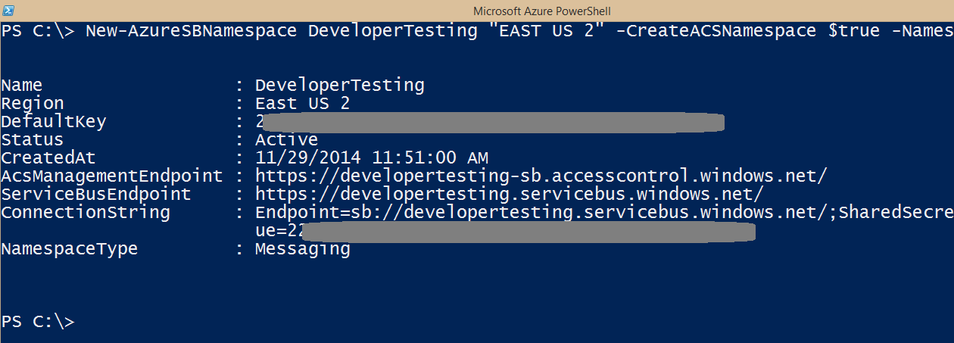
Debugging Event in Office 365
Addresses with http://localhost do not work!
You must use Azure Service Bus Namespace

Slide 15
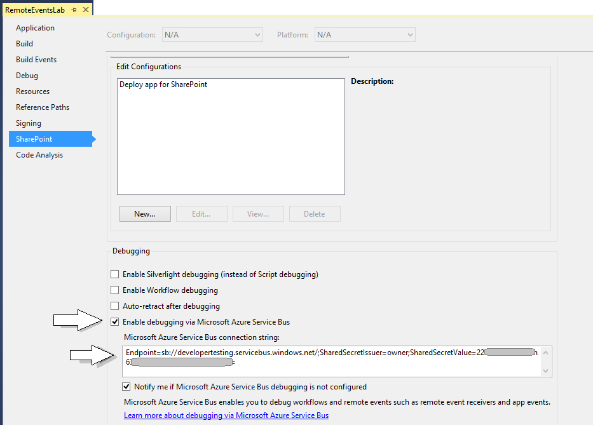
Visual Studio Debugging Support

Slide 16
demo
Creating an Azure Service bus namespace for debugging

Slide 17
Creating Remote Event Receivers

Slide 18
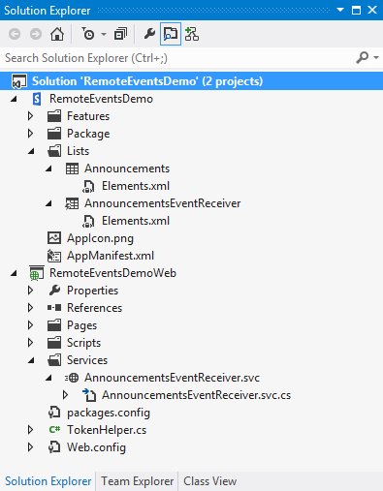
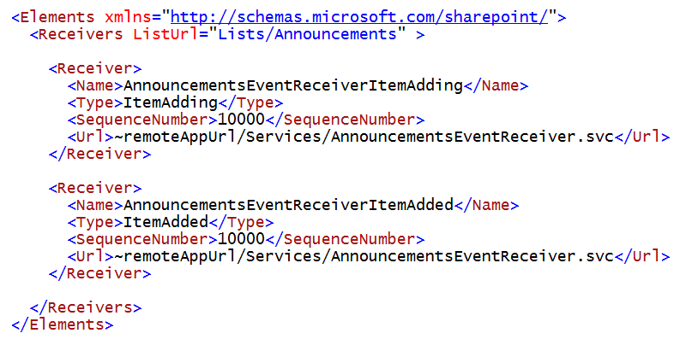
Registering Remote Events Receivers
Event receivers must be registered with SharePoint host
Registration can be declaratively for events occurring in app web
Registration for events occurring in host web requires code

Slide 19
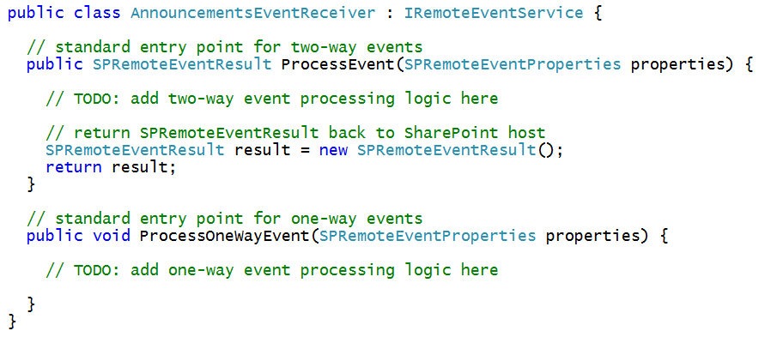
The Remote Event Receiver Entry Point
Remote event receiver implemented with .svc file
Event receiver code written as C# code code-behind .svc file
Event receiver is class that implements IRemoteEventService
ProcessEvent method executes when two-way event is triggered
ProcessOneWayEvent method executes when one-way event is triggered

Slide 20
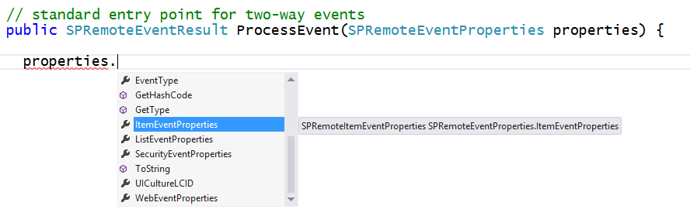
SPRemoteEventProperties
SPRemoteEventProperties parameter passed to event handlers
Provides you with contextual information about the current event
Allows you to read and update user input during before event
Makes it possible to perform validation in before events

Slide 21
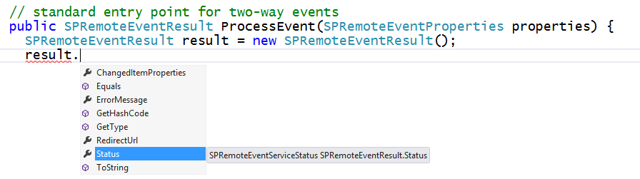
SPRemoteEventResult
Two-way event handlers return SPRemoteEventResult object
SPRemoteEventResult object makes it possible to cancel action

Slide 22
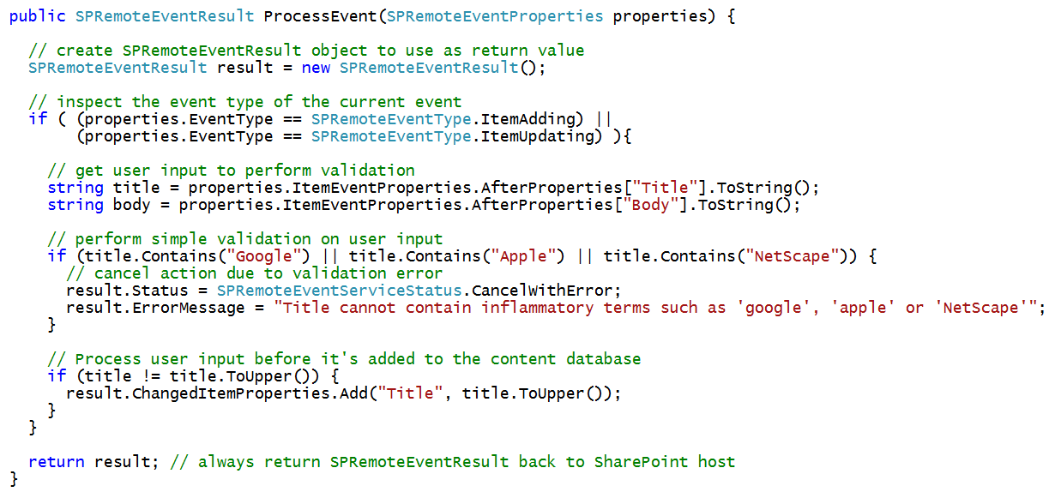
Example Before Event with a List Item

Slide 23
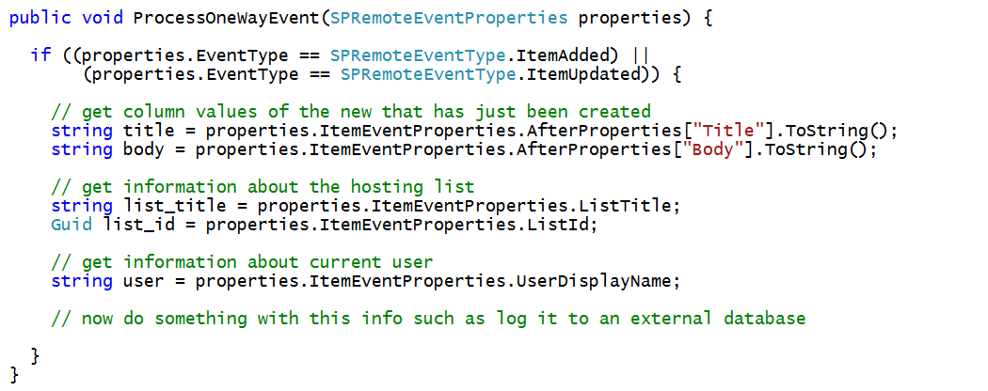
Example After Event with a List Item

Slide 24
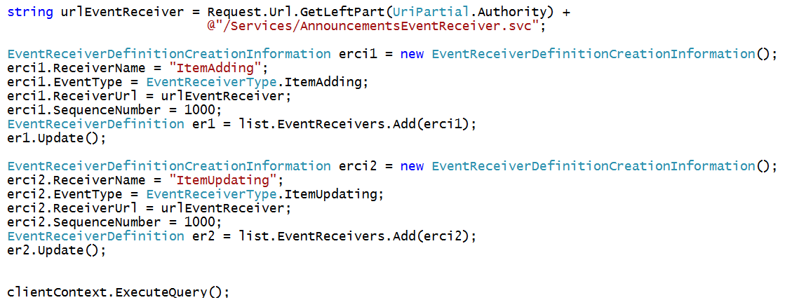
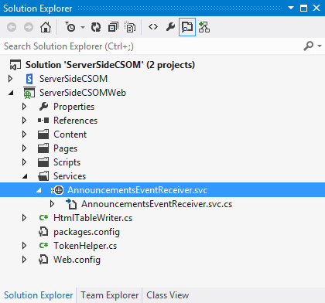
Registering Remote Event Receivers using CSOM
Remote Event Receivers require registration
Declarative registration only possible in app web
Registration in host web requires CSOM code
Remote web must supply the required entry point (e.g. MyEventReceiver.svc)

Slide 25
App Lifecycle Events

Slide 26
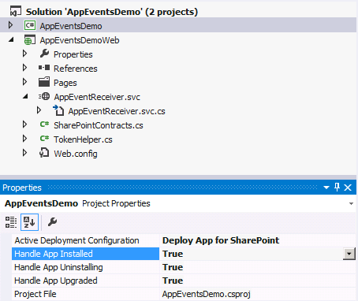
App Lifecycle Events
SharePoint app models support app events
App events for installation, upgrade and uninstall
Added to app project using property sheet
Implemented as a remote event receiver
Notes:
The installation, upgrade and uninstallation of an app raises events that developers can trap. These are surfaced as remote event receivers where the app calls out to a well known endpoint where the developer can do something upon these events.

Slide 27
App Lifecycle Event Registration
Declaratively register remote event receivers
Definitions found in AppManifest.xml
<Properties>
<Title>App Lifecycle Event</Title>
<StartPage>~appWebUrl/Pages/Default.aspx?{StandardTokens}</StartPage>
<InstalledEventEndpoint>~remoteAppUrl/AppEventReceiver.svc</InstalledEventEndpoint>
<UninstallingEventEndpoint>~remoteAppUrl/AppEventReceiver.svc</UninstallingEventEndpoint>
<UpgradedEventEndpoint>~remoteAppUrl/AppEventReceiver.svc</UpgradedEventEndpoint>
</Properties>
Notes:
Remote Event Receivers can also be set up for Installed, Uninstalling, and Upgrading events in the App lifecycle.
To handle a SharePoint app event, set its event value to True in Visual Studio. The default value for the events is False. When you set the value of an app event to True, Visual Studio creates an app event receiver. To disable an app event receiver, set its value to False

Slide 28
demo
Creating an AppInstalled Event handler

Slide 29
Summary
Remote Event Receiver Architecture
Debugging Remote Events
Creating Remote Event Receivers
App Lifecycle Events

Slide 30
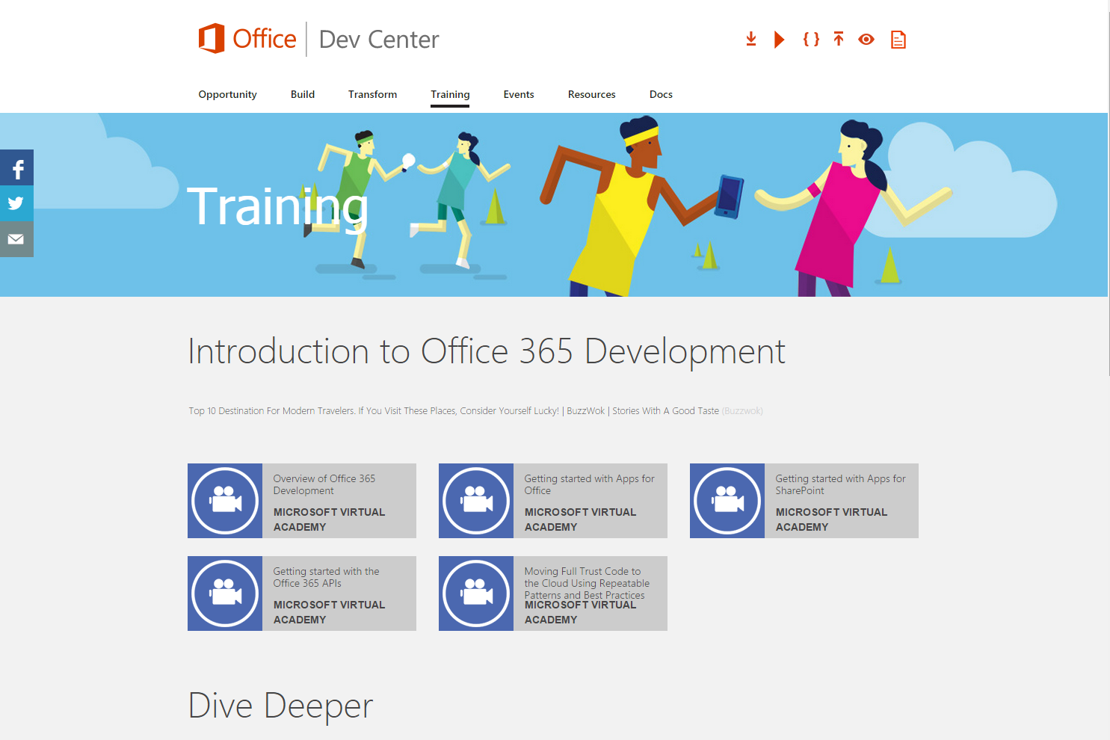
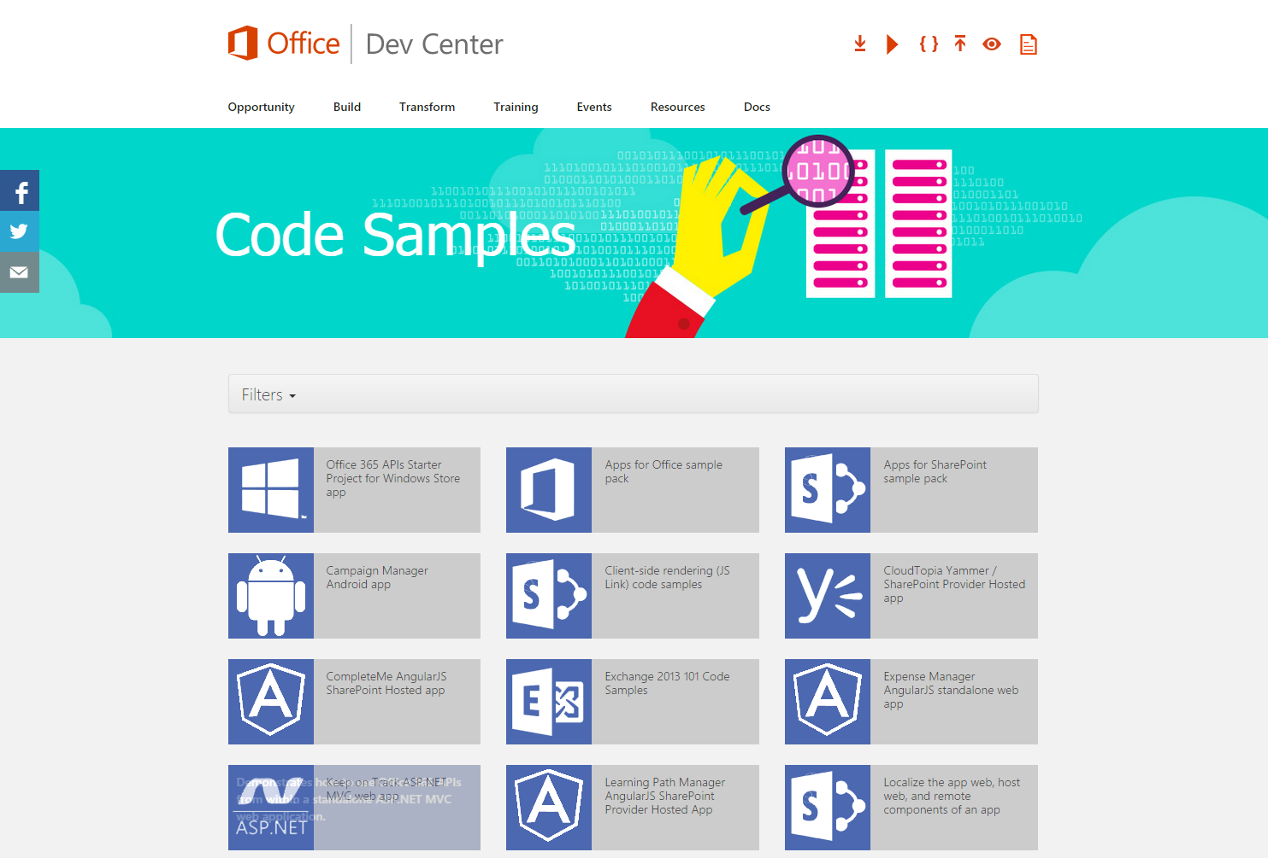
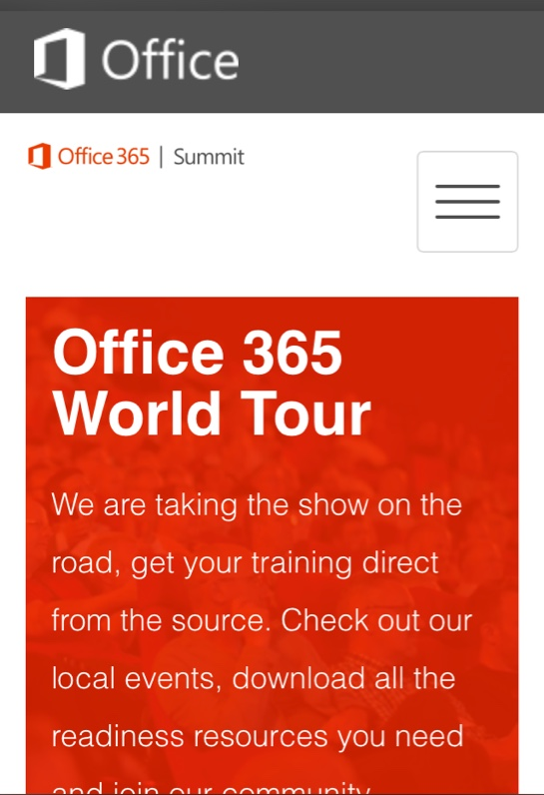
dev.office.com
Sign up
http://dev.office.com/getting-started
Explore
http://apisandbox.msdn.microsoft.com
Get trained http://dev.office.com/training

Slide 31


Feedback
Office 365 Network Share you best practices and join conversations https://www.yammer.com/itpronetwork
Stackoverflow Ask deep technical questions to a world-wide set of developers
http://stackoverflow.com/questions/tagged/ms-office
UserVoice Provide suggestions of what you want in future versions
http://officespdev.uservoice.com/

